Slide 1


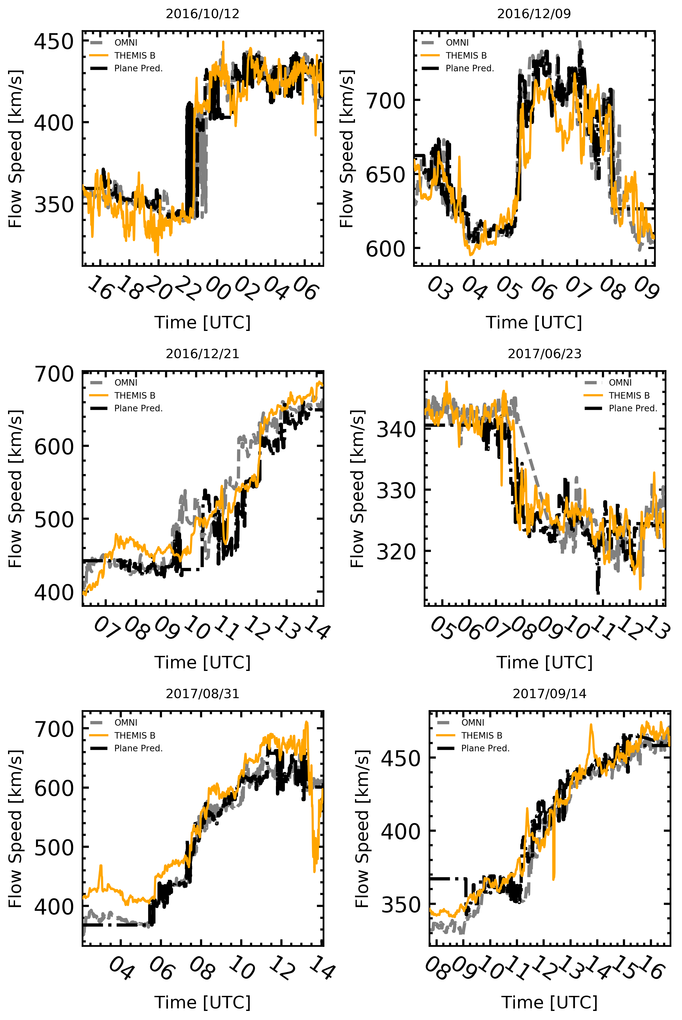
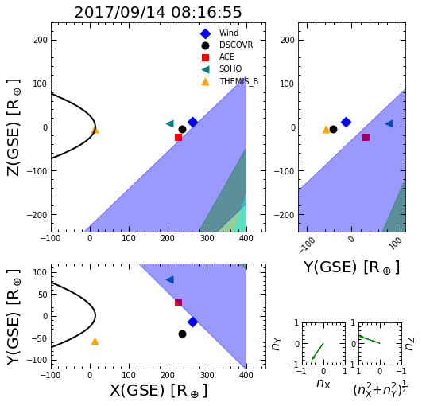
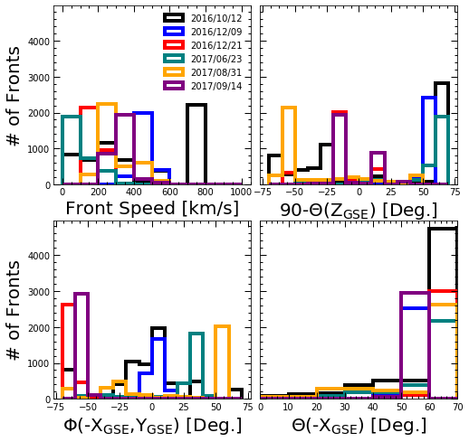
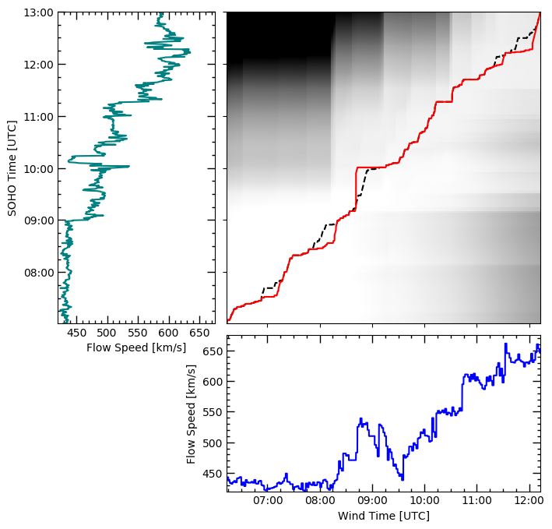



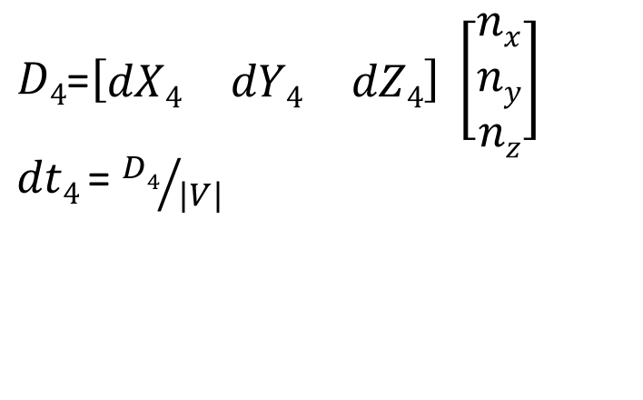
Multi-Spacecraft Predictions of Space Weather Fronts at Earth: Predictions Using Four L1 Spacecraft and Dynamic Time Warping Jakub Prchlik^{1,*}, Michael L. Stevens¹ ¹Center for Astrophysics | Harvard & Smithsonian, Cambridge, MA 02138 *jakub.prchlik@cfa.harvard.edu, https://github.com/jprchlik/solar_wind_matching
Results: Our Predictions, Themis-B, and OMNI
Figure 4. Examples downstream predictions of our DTW solutions at THEMIS-B (black, dash-dot). Also shown on the plot are the Omni predictions (gray, dashed, King & Papitashvili 2005) and the THEMIS-B observations (orange, solid). In general, we see a qualitative agreement between our predictions and the THEMIS-B observations, when limiting the phase front normal angle to be less than 70 degrees from –X_{GSE} (Weimer et al. 2002).
Introduction
Currently, space weather predictions of the solar wind at Earth primarily depend on solar wind measurements from two spacecraft, Wind and the Advanced Composition Explored (ACE). Using Wind and ACE, OMNI predicts solar wind conditions at Earth from L1 assuming a plane propagating normal to the ecliptic. Relying on two spacecraft for solar wind predictions at earth is not ideal, since the large scale structure of the solar wind is not required to be normal to the ecliptic. In addition to Wind and ACE, two other spacecraft, the Charge, Element, and Isotope Analysis System on the Solar and Heliospheric Observatory (SOHO/CELIAS) and Deep Space Climate Observatory (DSCOVR), exist at L1. They all regularly observe the proton spectra at approximately one minute resolution. DSCOVR, ACE, and Wind also possess magnetometers that have a time resolution less than 16s. Using the magnetic fields and proton parameters for these four spacecraft, we create a mathematically unique prediction of the solar wind properties at Earth by assuming the propagating front is a plane. We use a Dynamic Time Warping (DTW) algorithm to find the time offset between spacecraft. DTW allows for each observation in the solar wind of a given spacecraft to map to a single spacecraft. As such, we obtain a distribution of time offsets, thus a distribution of propagating solar wind planes. Here we present a series of time periods around solar wind discontinuities and compare the four spacecraft DTW solution to OMNI predictions and near Earth observations from THEMIS B. We find the DTW solution does a better job of predicting the observations in THEMIS B, especially when a front contains multiple discontinuities.
Observations
To account for observational uncertainty we regularize the data by subtracting the 5th percentile then normalizing by the 95th percentile. In particular, the SOHO/CELIAS solar wind speeds may be very different in magnitude and variance compared to ACE, DSCOVR, and Wind.
Analysis
Dynamic Time Warping (DTW) allows us to correlate features in time series observations. Originally adapted for speech recognition, we adopt the algorithm to match solar wind observations between spacecraft.
Analysis (Cont.)
To compute a DTW path you must search through the cost matrix to find the path of minimum cost. Since each index value corresponds to a time, the difference between each i,j along the optimal path is a time offset between observed features. As such, you may warp in time any spacecraft observation to another (Figure 2). We used Wind as the reference spacecraft. In order to account for the bulk time offsets between spacecraft, we first search for the average time offset by taking the mean time offset of the central hour allowing 85 minutes of compression. Then we reselected the data taking into account the bulk offset and find a second DTW path allowing for less compression (generally less than 30 minutes, Table 2).
Figure 2. The magnitude of the solar wind velocity (left) and the B_{Z} component of the magnetic field (right) as a function of time in the Wind (blue, diamond) reference frame. DSCOVR (black, circle), ACE (red, square), and SOHO/CELIAS (teal, triangle) are all warped to the Wind reference frame based on the best DTW solution. Interestingly, near 09 UT the plasma features in ACE and SOHO are different than Wind or DSCOVR.
Instrument | Plasma Cad. [s] | Mag. Cad. [s]
Wind (0) | 98 | 8
DSCOVR (1) | 60 | 10
ACE (2) | 64 | 16
SOHO (3) | 30 | N/A
THEMIS-B (4) | 4 | 4
Table 1. The time cadences for each spacecraft at L1 (column 1) in its plasma (column 2) and magnetic field observations (column 3). While the DSCVOR magnetic field observations could have a cadence as low as 1s, we decimate the observations because we find no improvement in the fit with the higher cadence observations. The decimated data speeds up the DTW algorithm.
$$\left[\begin{matrix}dt1 \\ dt2 \\ dt3\end{matrix}\right]=\left[\begin{matrix}dX1 & dY1 & dZ1 \\ dX2 & dY2 & dZ2 \\ dX3 & dY3 & dZ3\end{matrix}\right] \left[\begin{matrix}1/Vx \\ 1/Vy \\ 1/Vz\end{matrix}\right]$$
$D4$=$\left[\begin{matrix}dX4 & dY4 & dZ4\end{matrix}\right] \left[\begin{matrix}nx \\ ny \\ nz\end{matrix}\right]$
$dt4$ = ${D4}/{|V|}$
Equation 2. Solving for the velocity components
with a planar assumption.
Equation 3. Solving for the distance and time delay to THEMIS-B, where |V| is the magnitude of the velocity of the phase front.
Since there are currently four spacecraft at L1, we may assume a planar phase front. From the planar assumption, we may uniquely solve for the 3 components of the velocity by taking time and position offsets of three of the spacecraft compared to the remaining reference spacecraft at L1 (Equation 2). After we know the velocity components of the plane, we can calculate the distance and predict the time delay between the plane at the reference spacecraft (Equation 3).
Figure 5. The distribution of space weather phase front speeds (top left), normal with respect to the X,Y plane (top right), normal in the X,Y plane (bottom left), and normal with respect to –X_{GSE}. Note that the 2016/10/12 event has a large number of fronts in excess of 1000 km/s. Interestingly, phase front angles are near the limiting value (Table 2, bottom right). However, when we tried relaxing the limiting value the downstream prediction became unstable. Perhaps, at angles beyond 70 degrees with respect to –X_{GSE} the planar assumption breaks, which makes the predictions unreliable.
Figure 3. A series of space weather plane fronts on 2017/09/14 over-plotted on the positions of the spacecraft used in this study. The Earth’s bow shock is also shown for reference (black, solid). The 2017/09/14 event is likely the result of a corotating planar structure steaming from the northern coronal hole. As such, the propagating phase fronts for this event are generally visible in the following order: SOHO, ACE, Wind, DSCOVR, THEMIS-B. Further evidence of a corotating planar structure due to a coronal hole comes from the bottom right plot in Figure 4, which shows a slow rolling increase in solar wind speed.
Figure 1. An illustrative example of a DTW cost matrix (top right) with two different DTW paths over-plotted, using SOHO (left, teal) and Wind (bottom, blue) proton speed observations. The black dashed line correspond to matches between SOHO and Wind using our DTW algorithm, while the solid red line is the path in standard DTW.
Time [Wind, UTC] | Preceding Time [h] | Succeeding Time [h] | Rad 1 (min.) | Rad 2 (min.) | Max. Allowed Ang. (Deg.) | Match Param. [bar SOHO] | THEMIS-B Position GSE in Re
 |  |  |  |  |  |  | X | Y | Z
2016/10/12 21:16:14 | 7.5 | 9.0 | 85 | 30 | 70 | |B| | -43.1 | 37.8 | 0.1
2016/12/09 04:45:29 | 3.5 | 3.5 | 85 | 1 | 70 | |B| | -26.1 | 52.5 | -3.3
2016/12/21 08:43:12 | 2.5 | 4.5 | 85 | 30 | 70 | |B| | 2.7 | -62.6 | 2.3
2017/06/23 06:49:45 | 3.5 | 5.5 | 85 | 30 | 70 | |B| | 56.4 | -12.5 | -4.6
2017/08/31 04:35:27 | 3.5 | 8.5 | 85 | 30 | 70 | |B| | -25.4 | 57.6 | 4.4
2017/09/14 10:13:23 | 3.5 | 5.5 | 85 | 30 | 60 | |B| | 14.4 | -56.9 | -4.1
Table 2. The parameters used in each DTW solution shown in Figure 4. The order goes left to right then top to bottom.
Conclusions/Future Work
We present six time periods and see qualitatively our method produces reasonable predictions of the solar wind at THEMIS-B. However, we still need to put the predictive power on a quantitative ground. We also show the importance of maintaining at least four spacecraft solar wind measuring spacecraft at L1. It allows for mathematically unique solutions if one assumes solar wind phase fronts are planes. While the planar assumption is useful for science, it may also improve solar wind predictions at Earth if all four spacecraft took high cadence and fidelity observations.
$$D\left(i,j\right)=\left|\left(Yi−Yj\right)\right|+\min\left[D\left(i−1,j\right),D\left(i,j−1\right),D\left(i−1,j−1\right)\right]+P(i,j)$$
Equation 1. Computing each element in the cost matrix for DTW. The algorithm requires all elements left and below a given element are computed before a given element is computed. We add an additional parameter ($P(i,j)$) , which increases the cost of a particular element if outside a given range.
Notes:
Current space weather predictions depend on observations from one of two spacecraft, Wind or Ace. These predictions assume, among other things, that the propagation of the solar wind may be approximated by a plane normal to the ecliptic. Assuming the planar phase front is normal to the ecliptic is not necessarily motivated by the physics of the solar wind, so the current state of the art, OMNI, will make erroneous predictions if the solar wind phase front is highly inclined. Fortunately, we are in a unique time period where four spacecraft reside about an hour upstream at L1. These four spacecraft allow us to make mathematically unique predictions if we assume the propagating space weather phase fronts are planes.
We can make this calculation by calculating a series of time of position offsets (Equation 2). While the mathematics are simple, arriving at a continuous series of time offsets is non-trivial. To arrive at a series of time offsets we employ an iterative Dynamic Time Warping algorithm. The first iteration locates the bulk time offset in the solar wind between spacecraft, then the second iteration generally allows for 30 minutes of small scale timing variations in the solar wind between spacecraft. Comparing the time indices of the optimal Dynamic Time Warping path gives us the time offsets between features in the different spacecraft, which we can combine with the spacecraft’s position to find the plane describing solar wind phase front.
Now that we have a continuous series of solar wind phase fronts, we can propagate them to Earth or anywhere else in space (Figure 3 and Movie). Fortunately, the THEMIS spacecraft currently exist in near earth orbits, so we select time where THEMIS-B is outside Earth’s bow shock to measure the solar wind phase fronts. In general, we see good qualitative agreement between the planar predictions and the THEMIS-B observations (Figure 4). In many instances, our predictions appear to outperform OMNI. We should note that the OMNI predictions do not predict the space weather at THEMIS-B, so we expect a bit of a mismatch. However, in the 2017/09/14 event we would expect the OMNI prediction to be early, which is not what we observe. Likewise, the near hour disagreement on 2016/12/21 cannot be resolved by THEMIS-B’s position.
Interesting, many of the planar phase fronts in our predictions are near the classical 70 deg. cut off reccomended by Weimer et al. (2002). However, the predictions at THEMIS-B were unreliable if we relaxed this restriction. Perhaps, 70 degrees is a physical limit on what incident space weather phase fronts can be approximated by a plane.
In conclusion, we present 6 time periods and see a good qualitative agreement between THEMIS-B and our predictions. However, we still need to put our predictions on a firm quantitative ground. We also show the importance of maintaining 4 spacecraft at L1 and the possibility of an increased accuracy of the solar wind at Earth if 4 high cadence high fidelity observation spacecraft existed at L1
.

